Slide 1
Bonds (Quantitative Finance)

Slide 2
Bonds
A bond is a debt investment in which an investor loans
money to an entity (company or government)

Slide 3
Bonds
A bond is a debt investment in which an investor loans money to
an entity (company or government)
→ for a defined period of time
→ variable or fixed interest rate
BONDS ARE FIXED-INCOME SECURITIES !!!
So when a company needs to raise money to finance new projects they
may issue bonds directly to investors instead of obtaining loans form bank
→ interest rate of bonds are usually a bit higher
than that of the banks

Slide 4
Bonds
There are 2 main types of bonds:

Slide 5
Bonds
There are 2 main types of bonds:
zero-coupon bonds

Slide 6
Bonds
There are 2 main types of bonds:
zero-coupon bonds
coupon bonds

Slide 7
Zero-Coupon Bonds
$1000
10% rate
2 years

Slide 8
Zero-Coupon Bonds
this is the principal amount and
there are several synonyms
(par value, face value or nominal value)
THE PRINCIPAL AMOUNT IS PAID TO THE INVESTOR AFTER A SPECIFIED PERIOD OF TIME !!!
it is crucial that when dealing with
zero-coupon bonds no other
cash payment is made
$1000
10% rate
2 years

Slide 9
Zero-Coupon Bonds
$1000
this is the premium (interest rate)
the bond issuer is willing to pay to
the investor for the loan
10% rate
2 years

Slide 10
Zero-Coupon Bonds
$1000
10% rate
this is the maturity date
IT DEFINES THE END OF
THE AGREEMENT
at this time the bond issuer
redeems the bond by
paying the principal
2 years

Slide 11
Zero-Coupon Bonds
t=0
t=1
t=2
on our example this is the
maturity date (T) when the bond issuer
pays the principal amount

Slide 12
Zero-Coupon Bonds
$1000
t=0
t=1
t=2
on our example this is the
maturity date (T) when the bond issuer
pays the principal amount

Slide 13
Zero-Coupon Bonds
$1000
< $1000
t=0
t=1
t=2
on our example this is the
maturity date (T) when the bond issuer
pays the principal amount

Slide 14

Zero-Coupon Bonds
HOW MUCH WOULD YOU PAY FOR THIS BOND?
of course it has something to
do with the present value of the
actual principal amount
$1000
10% rate
2 years
$$\frac{x}{\left(1+r\right) }$$
n

Slide 15
Zero-Coupon Bonds
HOW MUCH WOULD YOU PAY FOR THIS BOND?
of course it has something to
do with the present value of the
actual principal amount
$1000
10% rate
2 years
$$\frac{x}{\left(1+r\right) }$$
n
note that this is
the market interest rate

Slide 16

Zero-Coupon Bonds
HOW MUCH WOULD YOU PAY FOR THIS BOND?
of course it has something to
do with the present value of the
actual principal amount
$1000
10% rate
2 years
$$\frac{1000}{\left(1+0.04\right) }$$
2

Slide 17
Zero-Coupon Bonds
HOW MUCH WOULD YOU PAY FOR THIS BOND?
of course it has something to
do with the present value of the
actual principal amount
$1000
10% rate
2 years
$$\frac{1000}{\left(1+0.04\right) }$$
2

Slide 18
Zero-Coupon Bonds
$1000
$924
t=0
t=1
t=2
on our example this is the
maturity date (T) when the bond issuer
pays the principal amount

Slide 19
Zero-Coupon Bonds
$1000
$924
t=0
t=1
t=2
on our example this is the
maturity date (T) when the bond issuer
pays the principal amount

Slide 20
Coupon Bonds
$1000
10% coupon
3 years

Slide 21
Coupon Bonds
this is the principal amount and
there are several synonyms
(par value, face value or nominal value)
THE PRINCIPAL AMOUNT IS PAID TO THE INVESTOR AFTER A SPECIFIED PERIOD OF TIME !!!
it is crucial that when dealing with
zero-coupon bonds no other
cash payment is made
$1000
10% coupon
3 years

Slide 22
Coupon Bonds
a coupon rate is stated as a
nominal percentage of the principal
amount of the given coupon bond
THE RATE OF INTEREST THE BOND PAYS ANNUALLY !!!
each coupon is redeemable
per period for that percentage
$1000
10% coupon
3 years

Slide 23
Coupon Bonds
$1000
this is the maturity date
IT DEFINES THE END OF
THE AGREEMENT
at this time the bond issuer
redeems the bond by
paying the principal
10% coupon
3 years

Slide 24
Coupon Bonds
t=0
t=1
t=2
t=3
on our example this is the
maturity date (T) when the bond issuer
pays the principal amount

Slide 25
Coupon Bonds
$1100
$100
$100
t=0
t=1
t=2
t=3
on our example this is the
maturity date (T) when the bond issuer
pays the principal amount

Slide 26
Coupon Bonds
HOW MUCH WOULD YOU PAY FOR THIS BOND?
of course it has something to
do with the present value of the
actual principal amount
+ we have to deal
with the annual coupon
payments as well
$1000
10% coupon
3 years

Slide 27
Coupon Bonds
$1100
$100
$100
t=0
t=1
t=2
t=3

Slide 28
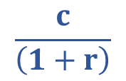
Coupon Bonds
$1100
$100
$100
t=0
t=1
t=2
t=3
$$\frac{c}{\left(1+r\right)}$$

Slide 29
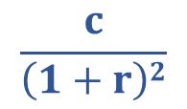
Coupon Bonds
$1100
$100
$100
t=0
t=1
t=2
t=3
$$\frac{c}{\left(1+r\right)2}$$

Slide 30

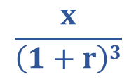
Coupon Bonds
$1100
$100
$100
t=0
t=1
t=2
t=3
$$\frac{c}{\left(1+r\right)3}$$
+
$$\frac{x}{\left(1+r\right)3}$$

Slide 31
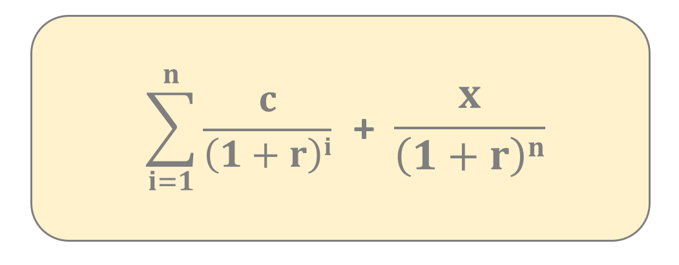
Coupon Bonds
we have to calculate the
present value of the
principal amount
when we calculate the present
value we always use the
market interest rate
we have to calculate the
present value of the
coupon payments

Slide 32
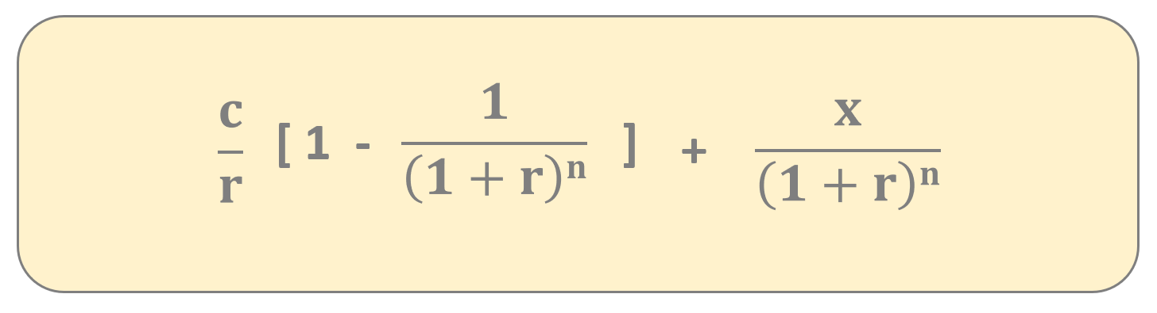
Coupon Bonds
we have to calculate the
present value of the
principal amount
when we calculate the present
value we always use the
market interest rate
we have to calculate the
present value of the
coupon payments

Slide 33
Coupon Bonds
$1100
$1167
$100
$100
t=0
t=1
t=2
t=3
so this is how we can calculate the price
of zero-coupon and coupon bonds
WE HAVE TO USE THE PRESENT VALUE OF THE PAYMENTS + PRINCIPAL !!!

Slide 34
Yield to Maturity (YTM) (Quantitative Finance)

Slide 35

Yield
yield is a figure that shows the return you get on a bond
we can caculate it with a simple formula
it defines how much money your investment is generating
$$\frac{annual coupon amount}{bond price}$$

Slide 36
Yield to Maturity
The yield to maturity of a bond is the internal rate of return (overall interest rate) earned
by an investor who buys the bond at t (today) at V market price
we assume that the bond is held until T maturity
all C_{i} coupon and P principal payments are made on schedule

Slide 37
Yield to Maturity
The yield to maturity of a bond is the internal rate of return (overall interest rate) earned
by an investor who buys the bond at t (today) at V market price
we assume that the bond is held until T maturity
all C_{i} coupon and P principal payments are made on schedule
P
V
„It is the y interest rate that
will make the present value
of the cash flows from the
investment equal to the
price (or cost) of the investment”
C_{i}
C_{i}
t
T

Slide 38
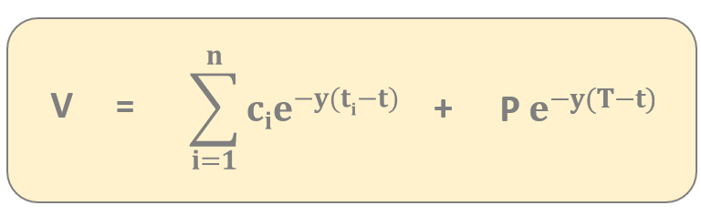
Yield to Maturity
we have to calculate the P
present value of the
principal amount
discounting everything
back to the t present
gives the current V price
we have to calculate the
present value of the
c_{i} coupon payments

Slide 39


Yield to Maturity
solve numerically
for y
$$\sum_{i=1}^{n}{cie^{−y(ti−t)} }$$
V =
+
P $$e^{−y(T−t)}$$

Slide 40
Yield Curve
of course longer bonds pay investors higher
interest rates – investors expect more yield in return
for loaning their money for a longer period of time
BECAUSE LONG-TERM BONDS POSE MORE RISK THAN SHORT-TERM BONDS
for example a more attractive investment
may arise or negative effects
may impact the bonds
yield (%)
time to
maturity (years)

Slide 41
Bonds Prices and Market Interested Rates
bonds and market interest rates are negatively correlated
when the cost of borrowing money rises bond
prices usually fall and vice-versa
THIS IS WHY THE MARKET INTEREST RATE IS SO IMPORTANT (IN MONETARY POLICY) !!!
of course if the market interest rate is high
enough than it is better to lend money to the bank
rather than buying bonds
bond price
(value)
market
interest rate

Slide 42


Macaulay Duration
Macaulay duration is a measure of how long it takes for the price of a bond to be repaid by the cash flows from it
it is the time an investor would take to get back all his invested money in the bond by the periodic interest as well as principal repayments
bond price
(value)
- $$\frac{1}{V}$$ $$\frac{dV}{dy}$$
for zero coupon
bonds the Macaulay
duration is the
same as the T time
to maturity
$$\frac{dV}{dy}$$
yield to
maturity

Slide 43


Macaulay Duration
bond prices and interest rates are negatively correlated
bonds with longer T maturity periods are more sensitive to changes in market interest rates than a bonds with short durations
the market interest rate increases which means
the bonds price may fall dramatically
T = 10 years
T = 4 years

Slide 44
Macaulay Duration
bond prices and interest rates are negatively correlated
bonds with longer T maturity periods are more sensitive to changes in market interest rates than a bonds with short durations
MACAULAY DURATION DEFINES HOW SENSITIVE THE BOND PRICE IS TO THE LITTLE CHANGE IN THE MARKET INTEREST RATE
investors prefer bonds with longer maturity when interest rates are expected to fall (and go down)
investors prefer bonds with short maturity when interest rates are either likely to go up or stay stable

Slide 45
Risks Associated with Bonds
INTEREST-RATE RISK
bond price moves in the opposite direction
to changes in interest rate

Slide 46
Risks Associated with Bonds
INTEREST-RATE RISK
bond price moves in the opposite direction
to changes in interest rate
DEFAULT RISK
the risk that the bond issuer may be unable to make
principal and coupon payments on time

Slide 47
Risks Associated with Bonds
INTEREST-RATE RISK
bond price moves in the opposite direction
to changes in interest rate
DEFAULT RISK
the risk that the bond issuer may be unable to make
principal and coupon payments on time
INFLATION RISK
this risk is caused by variations in the value of cash flows due to inflation as measured in terms of purchasing power

Slide 48
Stocks and Bonds
STOCKS
stocks are shares in
the ownership of a business
the holders of stock can vote on
certain company issues
a company has the option to
reward its shareholders
with dividends
stocks are riskier investments
than bonds
BONDS
bonds are a form of debt that the
issuing entity promises to repay at
some point in the future
bond holders have no
voting rights
no dividends
bonds are considered to be
safe investments

Slide 49
Modern Portfolio Theory (Quantitative Finance)

Slide 50
Modern Portfolio Theory
it was first formulated by Harry Markowitz back in 1952
he was later awarded with the Nobel prize in economics
it is a portfolio optimization model
it assists in the selection of the most efficient portfolio by considering various possible portfolios of the given securities based on expected return (mean) and risk (variance)
A portfolio is a collection of financial investments
such as stocks, bonds, commodities and cash

Slide 51
Modern Portfolio Theory
WHAT IS THE MAIN IDEA BEHIND MARKOWITZ-MODEL?
if we invest all of our money
into a single stock then we take
a huge risk because stock
are volatile
A SINGLE STOCK IS QUITE RISKY – BECAUSE IT IS UNPREDICTABLE !!!
we do not know for certain whether the
S(t) stock price will rise or fall
S(t)
t

Slide 52
Modern Portfolio Theory
WHAT IS THE MAIN IDEA BEHIND MARKOWITZ-MODEL?
we may combine multiple assets (stocks) in order
to reduce risk as much as possible
this is the main conclusion
of Markowitz-model
THIS IS CALLED DIVERZIFICATION !!!
combining assets is the main idea
and this is the same approach with
Black-Scholes model

Slide 53
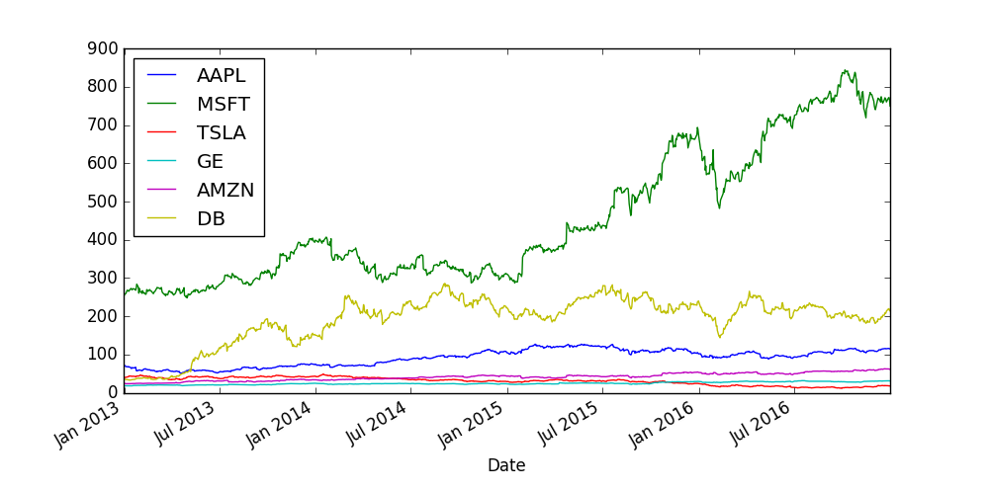
Modern Portfolio Theory
WHAT IS THE MAIN IDEA BEHIND MARKOWITZ-MODEL?

Slide 54
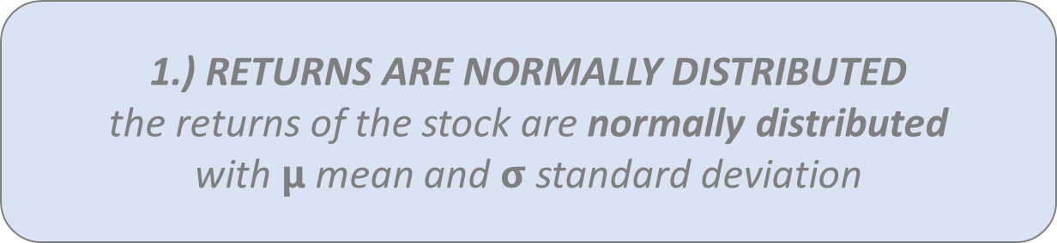
Modern Portfolio Theory
ASSUMPTIONS OF THE MARKOWITZ-MODEL
1.) RETURNS ARE NORMALLY DISTRIBUTED
the returns of the stock are normally distributed
with $$μ$$ mean and $$σ$$standard deviation

Slide 55
Modern Portfolio Theory
ASSUMPTIONS OF THE MARKOWITZ-MODEL
1.) RETURNS ARE NORMALLY DISTRIBUTED
the returns of the stock are normally distributed
with $$μ$$ mean and $$σ$$standard deviation
2.) INVESTORS ARE RISK-AVERSE
investors will take on more risk if they
are expecting more return

Slide 56
Modern Portfolio Theory
if there is a low risk (bonds) the return is low as well
with higher risk (stocks) the returns are usually higher
modern portfolio theory states that investors can construct optimal portfolios offering the maximum possible expected return for a given level of risk
SO THE EFFICIENT PORTFOLIO IS THE PORTFOLIO THAT
HAS THE HIGHEST REWARD FOR A GIVEN LEVEL OF RISK
OR THE LOWEST RISK FOR A GIVEN RETURN !!!

Slide 57
Modern Portfolio Theory
The investors are not allowed to set up short positions in a security so
100% of the wealth has to be divided among available assets (stocks) in a
way that all positions are long positions

Slide 58
Modern Portfolio Theory
The investors are not allowed to set up short positions in a security so
100% of the wealth has to be divided among available assets (stocks) in a
way that all positions are long positions
AAPL
20%
GOOGL
30%
TSLA
25%
GE
25%
weights = [0.2, 0.3, 0.25, 0.25]

Slide 59
Modern Portfolio Theory
The investors are not allowed to set up short positions in a security so
100% of the wealth has to be divided among available assets (stocks) in a
way that all positions are long positions
AAPL
20%
GOOGL
30%
TSLA
25%
GE
25%
weights = [0.2, 0.3, 0.25, 0.25]
We have to make sure the sum of weights is 1 because 100%
of the investor’s wealth is divided among the available assets

Slide 60
Modern Portfolio Theory
w_{i}
r_{i}
μ_{i}
this is the weight for
the i-th asset or stock
this is the return for
the i-th asset or stock
(historical data)
this is the expected return for
the i-th asset or stock
(mean of the returns)

Slide 61

Modern Portfolio Theory
$$\frac{S\left(t+1\right)−S(t)}{S(t)}$$
S(t)
this is how we can calculate
the daily return of a given stock
DAILY RETURN FOR A GIVEN STOCK !!!
we have to consider neighboring
[t,t+1] time steps
t
t
t+1

Slide 62


Modern Portfolio Theory
$$\frac{S\left(t+1\right)}{S(t)}$$
S(t)
$$ln$$
usually we use the logarithm
of the returns because
of mathematical convenience
LOG DAILY RETURNS ARE MORE POPULAR !!!
we have to consider neighboring
[t,t+1] time steps
t
t
t+1

Slide 63
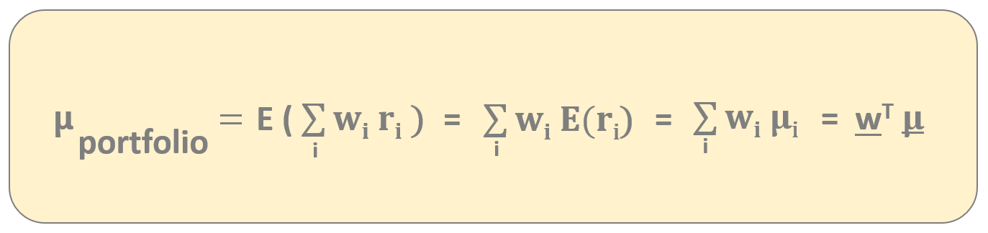
Modern Portfolio Theory
This model relies heavily on historical data – historical mean performance
is assumed to be the best estimator for future (expected) performance
EXPECTED RETURN OF THE PORTFOLIO !!!

Slide 64
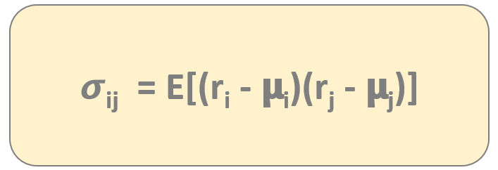
Modern Portfolio Theory
The risk of the portfolio can be measured by the volatility – that can be approximated
by the standard deviation or the variance
covariance defines how two
variables move together
𝞂_{ij} < 0 negative covariance means returns move inversely
𝞂_{ij} > 0 positive covariance means that asset returns move together
COVARIANCE IS CRUCIAL IN PORTFOLIO THEORY !!!

Slide 65
Modern Portfolio Theory
Markowit’z model is about diverzification which means we want to reduce risk as much as possible
possessing assets (such as stocks) with high positive σ_{ij} covariance does not provide much diverzification
the aim of diversification is to eliminate fluctuations in the long term
WE SHOULD INCLUDE UNCORRELATED STOCKS
IN THE PORTFOLIO INSTEAD !!!

Slide 66
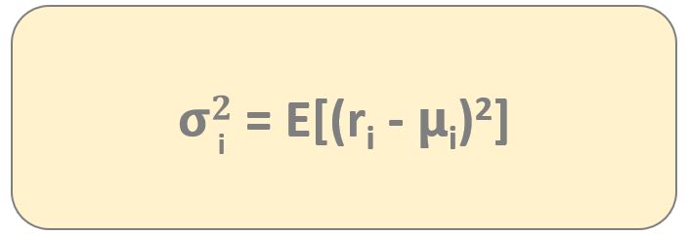
Modern Portfolio Theory
The risk of the portfolio can be measured by the volatility – that can be approximated
by the standard deviation or the variance
variance is the covariance
of variable with itself
For calculating the variance of the portfolio we need the
covariance matrix containing all the covariances
of the stocks involved in the portfolio !!!

Slide 67
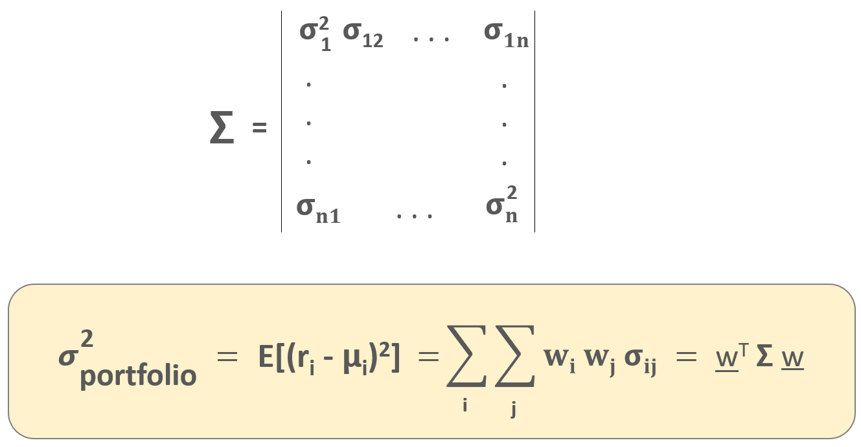
Modern Portfolio Theory
this covariance matrix
contains the relationship
between all the assets
(in this case stocks)
in the portfolio
EXPECTED PORTFOLIO VARIANCE !!!

Slide 68
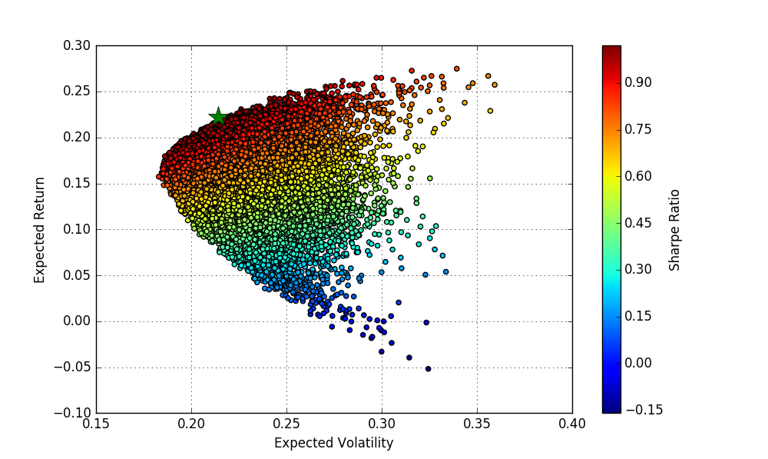
Modern Portfolio Theory
the dots represent different w
weights of a given portfolio containing
multiple stocks (so different portfolios)
An investor is interested in:
1.) the maximum return (mean) given a fixed
risk level (so volatility)
2.) minimum risk given a fixed return
These portfolios make up the so-called „efficient-frontier”
This is the main feature of Markowitz model the investor
can decide the risk or the expected return
IF YOU WANT TO MAKE MONEY, YOU HAVE TO TAKE RISK !!!

Slide 69
Modern Portfolio Theory
A
B
RETURN
C
D
RISK

Slide 70
Modern Portfolio Theory
RETURN
RISK

Slide 71
Modern Portfolio Theory
RETURN
RISK

Slide 72
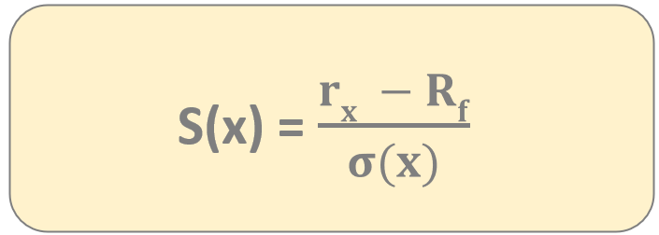
Sharpe Ratio
It is one of the most important risk and return measures used in
quantitative finance – it was first used by William Sharpe
It describes how much excess return you are receiving
for extra volatility that you endure holding a riskier asset (stock)
a Sharpe-ratio S(x) > 1
is considered to be good
r_{x}
average rate of return of investment x
R_{f}
rate of return of risk-free security

Slide 73
Capital Allocation Line
usually there are not just stocks
in out portfolio – we can consider
bonds and risk-free assets as well
WE CAN HAVE RISK-FREE ASSETS IN OUR PORTFOLIO AS WELL !!!
considering this fact what is the
optimal portfolio now?
the optimal portfolios lie on the
capital allocation line
this is the capital
allocation line
RETURN
portfolio with
maximum Sharpe-ratio
risk-free
asset
RISK

Slide 74
Monte-Carlo Simulations (Quantitative Finance)

Slide 75
Monte-Carlo Simulations
this method was first used back in the 1940s during the Manhattan Project at Los Alamos
John von Neumann, Stanislaw Ulam and Nicholas Metropolis applied this method to nuclear physics related problems
Monte-Carlo method solves a deterministic
problem using probabilistic methods

Slide 76
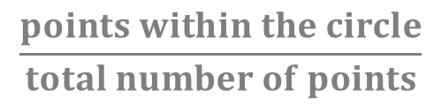
Monte-Carlo Simulations
for example we have to calculate the
area of the circle within a square
WE CAN GENERATE RANDOM POINTS
ON THE TWO-DIMENSIONAL PLANE
we just have to count the relative frequency
of points inside the circle
a
a
A_{circle} = a²
$$\frac{points within the circle}{total number of points}$$

Slide 77
Monte-Carlo Simulations
WHAT IS THE BASIC PRINCIPLE?
we can estimate the possible outcomes of an uncertain events
have to generate several possible outcomes and then we have to calculate the average of these outcomes
the more iterations we make the better will be the prediction

Slide 78
Monte-Carlo Simulations
dS = 𝝻 S dt + 𝞂 S dX
we know that S(t) assets (such as stocks)
follow lognormal random work
IF WE KNOW THE S(0) STARTING POINT OF THE STOCK PRICE AND WE KNOW THE 𝝻 and 𝞂 PARAMETERS
THEN WE CAN MAKE MULTIPLE SIMULATIONS
it is quite cheap to create simulations like these we know
how to simulate lognormal random walks
THE AVERAGE OF THESE SIMULATIONS YIELDS THE FUTURE S(t) PRICE OF THE STOCK !!!

Slide 79
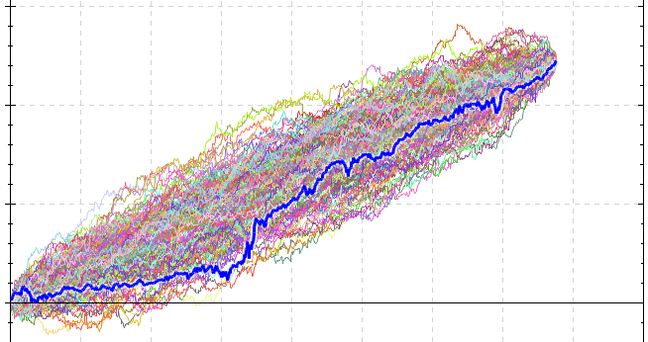
Monte-Carlo Simulations

Slide 80
Capital Asset Pricing Model (CAPM) (Quantitative Finance)

Slide 81
Capital Asset Pricing Model (CAPM)
the Capital Asset Pricing Model (CAPM) was first formulated by William F. Sharpe back in the early 1960s
linear relationship between any stock expected return and the market premium

Slide 82
Capital Asset Pricing Model (CAPM)
expected return of investment – it may be a single stock or a portfolio
E[r_{a}] = r_{f} + β_{a} ( E[r_{m}] – r_{f} )

Slide 83
Capital Asset Pricing Model (CAPM)
expected return of investment – it may be a single stock or a portfolio
E[r_{a}] = r_{f} + β_{a} ( E[r_{m}] – r_{f} )
base return
because of
risk-free rate

Slide 84
Capital Asset Pricing Model (CAPM)
expected return of investment – it may be a single stock or a portfolio
E[r_{a}] = r_{f} + β_{a} ( E[r_{m}] – r_{f} )
base return
because of
risk-free rate
market excess return or the market premium multipled by a factor

Slide 85
Capital Asset Pricing Model (CAPM)
expected return of investment – it may be a single stock or a portfolio
E[r_{a}] = r_{f} + β_{a} ( E[r_{m}] – r_{f} )
base return
because of
risk-free rate
market excess return or the market premium multipled by a factor
LINEAR RELATIONSHIP BETWEEN ANY STOCK
EXPECTED RETURN AND MARKET PREMIUM !!!
(we can use S&P500 index as the market)

Slide 86
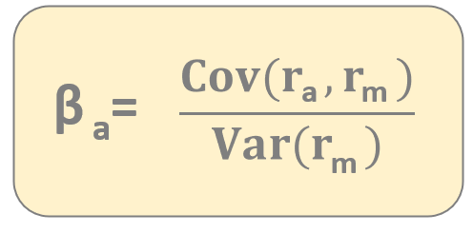
Capital Asset Pricing Model (CAPM)
the parameter defines how risky
your portfolio relative to the market
according to Capital Asset Pricing Model (CAPM) the β parameter is the
only relevant measure of a stock’s risk
the β parameter measures the stock’s relative volatility – how much the
price of a given stock goes up or down compared to that of the whole market

Slide 87
Capital Asset Pricing Model (CAPM)
the parameter defines how risky
your portfolio relative to the market
→ if your portfolio has no risk then your expected return is the
risk-free return (you can lend your money to a bank or government)
→ your portfolio is more risky than the market then your return
will be higher of course
→ your portfolio less risky than the market – less return
β = 1 stock moving exactly with the market has beta 1
β > 1 given stock is more volatile than the market (more expected return)
β < 1 given stock is less volatile than the market (less expected return)

Slide 88
Capital Asset Pricing Model (CAPM)
the parameter defines how risky
your portfolio relative to the market
β = 0.5
less volatile than the market
Stock market goes up by 10% → this stock goes up by 5%
Stock market falls by 2% → this stock falls by 1%
β = 1.5
50% more volatile than the market
Stock market goes up by 10% → this stock goes up by 15%
Stock market falls by 2% → this stock falls by 3%

Slide 89
Capital Asset Pricing Model (CAPM)
GOOGL
We know how to calculate the β beta
for a single stock
→ just have to calculate the covariance and
the variance of the market
How to deal with a portfolio containing
several stocks?
Motorola
TSLA
IBM
A given portfolio’s β beta value is the weighted sum of the
stocks’ betas within the portfolio
β_{a} = w₁ β₁ + w₂ β₂ + ... + w_{n} β_{n}

Slide 90
Capital Asset Pricing Model and Regression (Quantitative Finance)

Slide 91
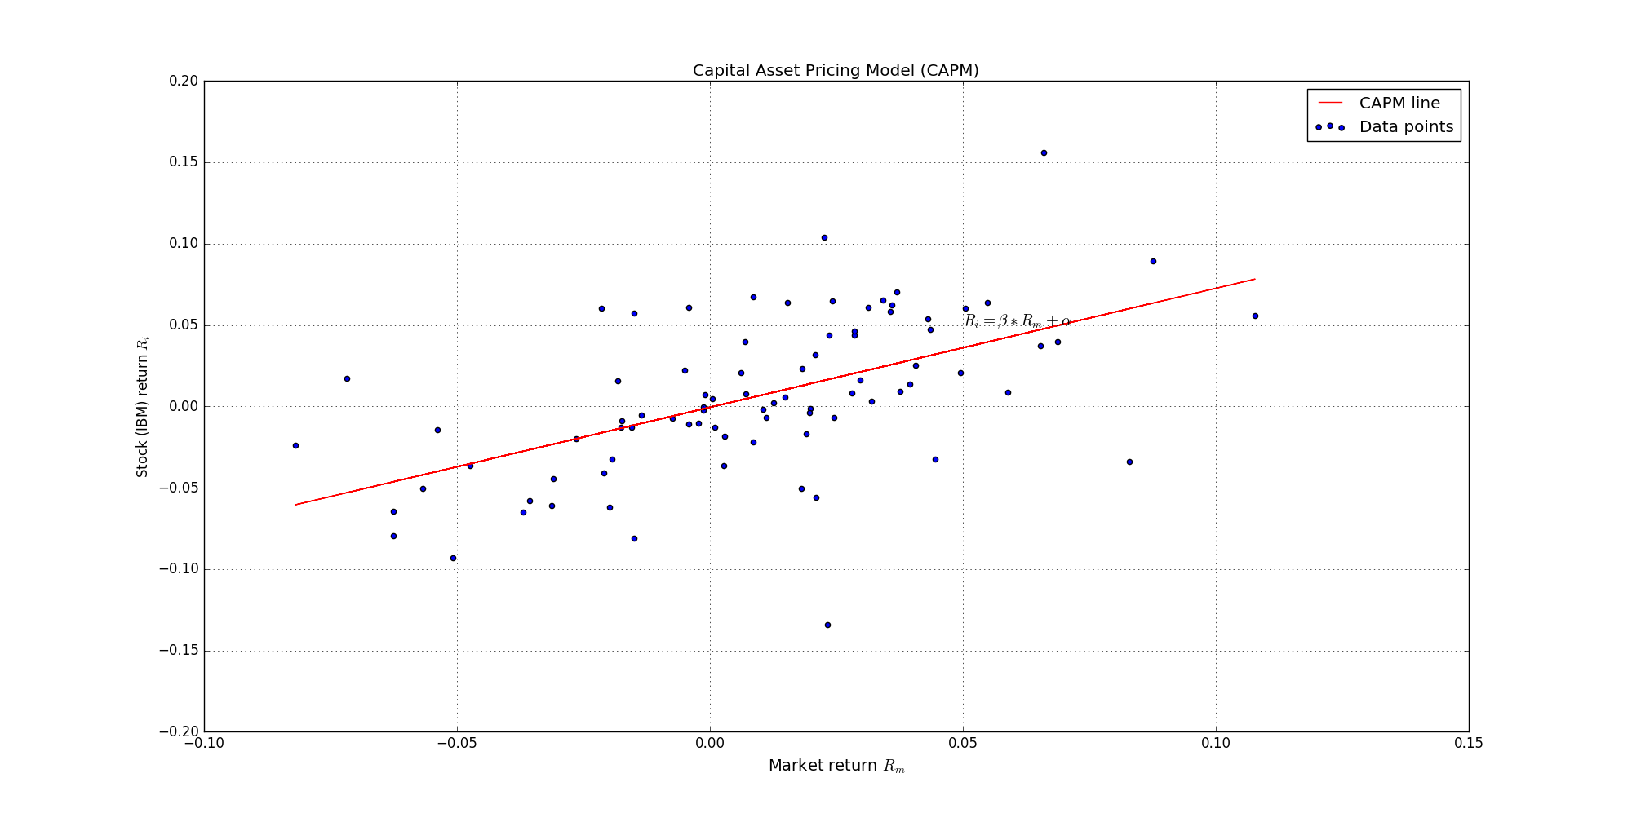
Capital Asset Pricing Model and Regression
E[r_{a}] - r_{f} = α + β_{a} ( E[r_{m}] – r_{f} )

Slide 92
Capital Asset Pricing Model and Regression
The β beta is the only relevant measure of risk – it determines the
additional premium beyond the risk-free rate
What is α alpha?
The α alpha parameter is the difference between the
return and the expected return !!!
α = E[r_{a}] - { r_{f} + β_{a} ( E[r_{m}] – r_{f} ) }
For example: CAPM may estimate that a portfolio should earn 15%
but it actually earned 20%. In this case α alpha
is the difference so 5%
FOR CAPM ALPHA IS ZERO !!!

Slide 93
Interest Rate Modeling (Quantitative Finance)

Slide 94
Interest Rate Modeling
r(t)
the main problem is that r(t) market
interest rates are fluctuating all the time
COMPANIES THAT HAVE LOANS ARE
DEPENDING ON THE INTEREST RATE !!!
+ we need the r(t) interest rate
when pricing bonds as well
t

Slide 95
Vasicek Model
this model was first introduced in 1977 by Oldřich Vašíček
this is a simple short-rate r(t) model
bonds, mortgages and credit derivatives are quite sensitive to r(t) interest rate changes
interest rate modeling is considered quite a complex topic
r(t) interest rates are affected by several factors – political decisions, government intervention and economic states

Slide 96
Vasicek Model
The Vasicek model assumes that the r(t) interest rates follows
a mean-reverting Ornstein-Uhlenbeck process
there is a stochastic random noise
defined by σ standard deviation
THIS MODEL ALLOWS
r(t) INTEREST RATES TO
BE NEGATIVE !!!
dr(t) = Ϗ (θ-r(t))dt + σ dW(t)
the r(t) interest rate fluctuates
around θ – where Ϗ is the speed
of mean reversion

Slide 97
Bond Pricing with Vasicek Model (Quantitative Finance)

Slide 98

Zero-Coupon Bonds
HOW MUCH WOULD YOU PAY FOR THIS BOND?
of course it has something to
do with the present value of the
actual principal amount
$1000
10% rate
2 years
$$\frac{x}{\left(1+r\right) }$$
2

Slide 99
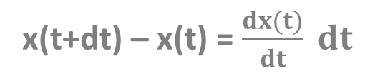
Zero-Coupon Bonds
We may construct a continuous model with differential equations
Suppose we have amount x(t) in the bank at time t. How much does this
increase in value from one day to the next?
x(t+dt) – x(t) = $$\frac{dx(t)}{dt} dt$$
Taylor-expansion or the
definition of derivatives
the change in the amount of
money within a dt day
But the interest I receive must be proportional to the actual x(t) amount
I have and the r interest rate and the dt time step !!!
x(t+dt) – x(t) = r x(t) dt

Slide 100

Zero-Coupon Bonds
We may construct a continuous model with differential equations
Suppose we have amount x(t) in the bank at time t. How much does this
increase in value from one day to the next?
$$\frac{dx(t)}{dt}=r x(t)$$
this is the differential equation
describing the change of our x(t) capital
The solution of this differential equation is x(t) = x(0) e
so the exponential function.
Of course if we want to get the present value of a
future cashflow then we have to use the exponential
function with negative exponent.
r t

Slide 101


Vasicek Model and Bond Pricing
Here we assume that the r(t) interest rate is not constant – it follows a stochastic process
Suppose the principal value of the bond is $x. How much would you pay for this
bond in the present?
$$_{t}^{T}{r\left(s\right)ds}$$
we have to calculate the discounted
value of a future cashflow
+ handle the stochastic r(t)
-
$$P=x e$$
we can solve this equation (as well as the Vasicek model)
but we will use Monte-Carlo simulation instead

Slide 102
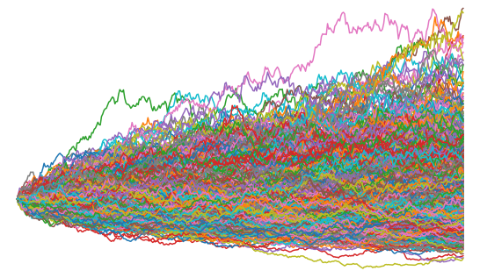
Vasicek Model and Bond Pricing
r(t)
we generate a huge amount of possible
r(t) interest processes
THE MEAN OF THESE SIMULATIONS YIELDS THE r_{B}(t) INTEREST RATE WITH THE HIGHEST
PROBABILITY IN THE FUTURE !!!
then we can use this expected interest rate
to calculate the price of the bond
t

Slide 103
Vasicek Model and Bond Pricing
f(t)
if we want to calculate the integral of a
given f(x) function
WE USE RECTANGLES AND WE SUM UP THE AREA OF THESE RECTANGLES !!!
of course the smaller rectangles we use the better
will be the result of the calculation
t

Slide 104
Vasicek Model and Bond Pricing
f(t)
if we want to calculate the integral of a
given f(x) function
WE USE RECTANGLES AND WE SUM UP THE AREA OF THESE RECTANGLES !!!
of course the smaller rectangles we use the better
will be the result of the calculation
t

Slide 105
Option Pricing with Monte-Carlo Method (Quantitative Finance)

Slide 106


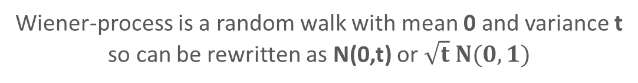
Option Pricing with Monte-Carlo Simulation
For an option the underlying asset (stock) follows a geometric random walk
→ so by simulating these stochastic processes we can determine
the price of financial instruments (option)
dS(t) = μ S(t) dt + σ S(t) dW
We can obtain the log S(t) because we know that stock prices
can not be negative. So let’s use Ito’s lemma with F(S) = log S(t)
d log S(t) = ( μ - $$\frac{1}{2} σ^{2}$$)dt + σ dW
log S(t) = log S(0) + ( μ - $$\frac{1}{2} σ^{2}$$) t + σ $$_{0}^{t}{dW}$$
Wiener-process is a random walk with mean 0 and variance t
so can be rewritten as N(0,t) or $$\sqrt{t} N(0,1)$$

Slide 107
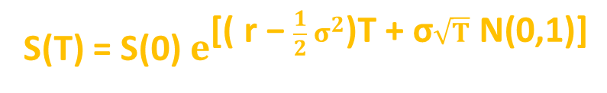
Option Pricing with Monte-Carlo Simulation
If we make a risk-neutral assumption: the μ drift becomes
the r risk-free interest rate
this exponential function
defines the S(t) stock
price at T maturity
S(T) = S(0) $$e^{[( r − \frac{1}{2} σ^{2})T + σ\sqrt{T} N(0,1)]}$$
in Monte-Carlo simulation we generate a large amount of stock
price estimates with this equation
the option price is the expected value of a pay-off function
+ we have to use a discounted factor (time value of money)
max(S-E,0) max(E-S,0)
call option
put option

Slide 108
Black-Scholes Model
It was published in 1973 by Fisher Black, Robert Merton and Myron Scholes
~ they were constructed a model that can yield the V(S,t) option
price when t<T
THEY SHOWED THAT COMBINING RISKY ASSETS
CAN ELIMINATE RISK ITSELF !!!
Modern Portfolio Theory is about including several stocks in
a portfolio in order to reduce unsystematic risk
CAPM is about β: because we can eliminate unsystematic risk, the
only relevant risk is market risk
~ market risk cannot be diversified away !!!
Market-neutral strategyies: delta-hedging and pairs-trading
can eliminate all risk !!!

Slide 109
Black-Scholes Model
The V(S,t,...) value of an option is a function of various parameters
V( S , t , σ , μ , E , T , r )
stock price and time
are variables
parameter associated with
risk-free rate
volatility and mean are
parameters associated
with the stock price
strike price and expiry
are parameters associated
with the given option

Slide 110
Black-Scholes Model
Call option: this is the right to buy a particular asset (stock) for an agreed
amount at a specific time in the future
call option will rise in value if the underlying asset rises and
fall if the asset falls
WHY? Of course, the greater the value of S(t) stock, the greater
the payoff at T expiry
POSITIVE CORRELATION BETWEEN TWO ASSETS !!!

Slide 111
Black-Scholes Model
Put option: this is the right to sell a particular asset (stock) for an agreed
amount at a specific time in the future
NEGATIVE CORRELATION BETWEEN TWO ASSETS !!!
we can exploit these correlations to end up with a
rather special portfolio
π = V(S,t) - 𝛥S
long position
short position
This special π portfolio contains a long position in the V(S,t) option
and a short position in the S(t) underlying stock
What is 𝛥? We short just some quantity of the underlying

Slide 112
Black-Scholes Model
Assumption: the underlying asset follows a lognormal random walk
dS = 𝝻 S dt + 𝞂 S dX
What about the change in the portfolio’s value?
The π portfolio changes from time t to t+dt: first of due to change in
the V(S,t) option value + because of the change in the S(t)
underlying asset
dπ = dV(S,t) - 𝛥dS
How to deal with these changes? With the help of Ito’s lemma
we can handle these changes

Slide 113












Black-Scholes Model
2
$$\frac{∂V}{∂t}$$ dt
$$\frac{∂V}{∂S}d$$S
$$\frac{∂ V}{∂S}d$$t
+
+
$$\frac{1}{2}$$ σ S
dV(S,t) =
2
2
2
2
$$\frac{∂V}{∂S}d$$S
$$\frac{∂ V}{∂S}d$$t
$$\frac{∂V}{∂t}$$ dt
+
+
$$\frac{1}{2}$$ σ S
+
2
2
dπ = - 𝛥dS
2
2
$$\frac{∂V}{∂S}$$
$$\frac{∂ V}{∂S} )d$$t
( $$\frac{∂V}{∂t}$$
$$\frac{1}{2}$$ σ S
+
+
+
2
2
dπ = ( - 𝛥)dS
2
deterministic part
stochastic part

Slide 114




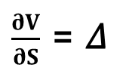
Black-Scholes Model
Delta-hedging:
The change in the portfolio has a deterministic part and a
stochastic part
2
$$\frac{∂V}{∂S}$$
$$\frac{∂ V}{∂S} )d$$t
( $$\frac{∂V}{∂t}$$
$$\frac{1}{2}$$ σ S
+
+
+
2
2
dπ = ( - 𝛥)dS
2
deterministic part
stochastic part
$$\frac{∂V}{∂S}$$ = 𝛥
if we choose delta like this, risk
is reduced to zero
any elimination in randomness is called hedging
delta hedging: the perfect elimination of risk because of
exploiting the correlation between two assets
~ it is an example of dynamic hedging

Slide 115
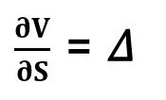




Black-Scholes Model
Delta-hedging:
$$\frac{∂V}{∂S}$$ = 𝛥
„dynamic delta-hedging”
Of course this 𝛥 is changing all the time: the perfect hedge must be
continually rebalanced
2
$$\frac{∂V}{∂S}$$
$$\frac{∂ V}{∂S} )d$$t
( $$\frac{∂V}{∂t}$$
$$\frac{1}{2}$$ σ S
+
+
+
2
2
dπ = ( - 𝛥)dS
2
deterministic part
stochastic part
so we just have to deal with the
deterministic part exclusively

Slide 116



Black-Scholes Model
No arbitrage principle:
We can use dynamic hedging to eliminate all the risk
~ we have just the deterministic part
2
$$\frac{∂ V}{∂S} )d$$t
( $$\frac{∂V}{∂t}$$
$$\frac{1}{2}$$ σ S
+
+
2
2
dπ =
2
This change is completely riskless: but risk-free asset has
something to do with r risk-free rate
The risk-free dπ change must be the same as the growth we would get if we
lend the same amount of cast to a bank:
dπ = r π dt
„no arbitrage principle”

Slide 117
Black-Scholes Model
No arbitrage principle:
Let’s consider it is not true: why can we make a riskless profit?
Arbitrage: when the investor can make riskless money !!!
if we can get a greater return with the delta-hedged portfolio: we
could borrow money from the bank ... pay interest at rate r
invest that money into risk-free option/stock portfolio
and we could make a profit !!!
usually we can assume there are no arbitrage opportunities
OR if there are ... just for a very short time !!!

Slide 118








Black-Scholes Model
2
$$\frac{∂V}{∂S}$$
$$\frac{∂ V}{∂S} )d$$t = r ( V – S ) dt
( $$\frac{∂V}{∂t}$$
$$\frac{1}{2}$$ σ S
+
+
2
2
2
2
$$\frac{∂V}{∂S}$$
$$\frac{∂ V}{∂S}$$– r S
$$\frac{∂V}{∂t}$$
+
$$\frac{1}{2}$$ σ S
+
2
2
- r V = 0
2
„Black-Scholes equation”
it is a parabolic partial differential equation
linear: so the sum of the solutions is also a solution
financial equations are usually parabolic: they are related to heat
and diffusion equations of physics !!!

Slide 119


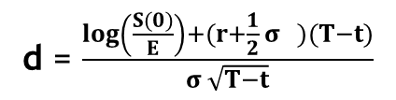

Black-Scholes Model
Solution to Black-Scholes equation: no dividend yields on the underlying
$$_{−∞}^{x}{e^{−\frac{z}{2}}}$$
$$\frac{1}{\sqrt{2π}}$$
2
N(x) =
dz
standard normal distribution
CALL OPTION PUT OPTION
-r(T-t)
-r(T-t)
S(0)N(d ) – E e N(d )
-S(0)N(-d ) + E e N(-d )
1
2
1
2
d = $$\frac{\log\left(\frac{S(0)}{E}\right)+(r+\frac{1}{2} σ )(T−t)}{σ \sqrt{T−t}}$$
2
1
d = d – σ $$\sqrt{T−t}$$
2
1

Slide 120

The Greeks
1.) Delta: 𝛥
The delta of an option/portfolio is the sensitivity of the
option/portfolio to the underlying
𝛥$$= \frac{∂V}{∂S}$$
~ the delta of a portfolio is the sum of deltas of
all individual positions
it is important when dealing with delta-hedging
We can eliminate risk if we make sure delta is
equals to the derivative !!!

Slide 121

The Greeks
2.) Gamma: 𝛤
The gamma of an option/portfolio is second derivative of the
position with respect to the underlying
2
𝛤$$= \frac{∂ V}{∂S }$$
2
~ basically it is the sensitivity of 𝛥 delta
gamma is a measure of how often a position must be rehedged in
order to maintain a delta-neural position
Delta-neutral: it means the portfolio value remains unchanged when small
changes occur in the value of the underlying
This is what Black-Scholes model about !!!

Slide 122


The Greeks
3.) Theta: 𝛩
Theta is the rate of change of the option price with time:
𝛩$$=\frac{∂V}{∂t}$$
4.) Vega:
Some models rely heavily on the volatility so it may be important
to monitor the change according to volatility
$$\frac{∂V}{∂σ}$$

Slide 123
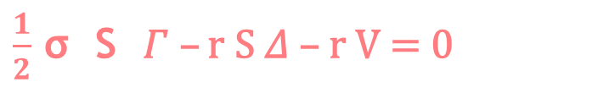

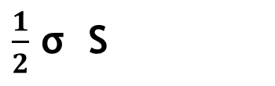
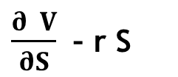

The Greeks
Black-Scholes formula:
2
$$\frac{∂V}{∂S}$$
$$\frac{∂ V}{∂S}$$– r S
$$\frac{∂V}{∂t}$$
$$\frac{1}{2}$$ σ S
+
+
2
2
- r V = 0
2
theta
gamma
delta
$$\frac{1}{2}$$ σ S 𝛤 – r S 𝛥 – r V = 0
2
𝛩 +
2
„Black-Scholes formula with the greeks”

Slide 124
Implied Volatility
Most of the parameters are straightforward when dealing
with the Black-Scholes model
V(S,t,σ,μ,E,T,r)
HOW TO CALCULATE VOLATILITY?
→ volatility has something to do with the option price
What volatility should the investor use to get the correct market price
of the given option? This is called implied-volatility !!!
We have to solve the Black-Scholes equation:
V (S,t,σ,μ,E,T,r) = known value
Black-Scholes
We can use Newton-Raphson method to find σ

Slide 125
Black-Scholes Model
How to make money with Black-Scholes model?
several investors use these kinds of models to
eliminate risk
So calculate the greeks to hedge a given portfolio
→ you can use Black-Scholes model to find mispriced options
in the market
~ you can buy or sell accordingly to make a profit

Slide 126
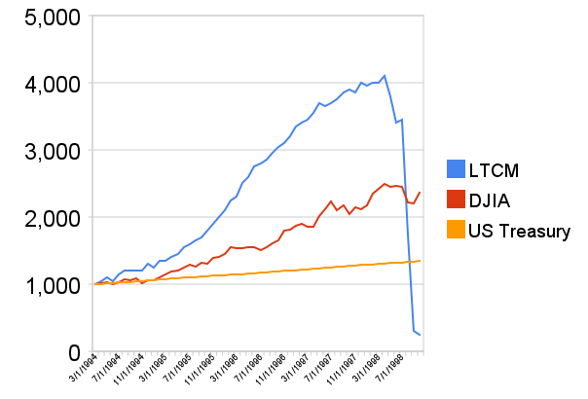
Long Term Capital Management (LTCM)
this hedge fund was founded in 1994 by the former vice-chairman
of Salomon Brothers – John W. Meriwether
lots of members were academics: such as the Nobel-prize winner
Myron Scholes and Robert C. Merton
~ they used quite complex models such as paris-trading or
Black-Scholes model !!!

Slide 127
Long Term Capital Management (LTCM)
Because of the asian financial crisis in 1997 and
the russian financial crisis in 1998 LTCM collapsed
What as the key of success?
The quants in LTCM tried to hedge market risk
There are two approaches: Black-Scholes model
and pairs-trading strategy
MARKET-NEUTRAL STRATEGIES !!!
market-neutral strategy tries to profit from both increasing
and decreasing stock prices
usually combining long and short positions
in different assets

Slide 128
Long Term Capital Management (LTCM)
Pairs-trading strategy:
Combining long and short positions in a pair of highly correlated
financial instruments (such as stocks)
~ it is a form of statistical-arbitrage strategy
developed in the 1980s
If the correlation between the two stocks weakens: investor should long the
underperforming stock and short the outperforming stock → because they are
expected to converge in the future
For example: CocaCola and Pepsi
~ they have similar business idea so they are similar

Slide 129
Long Term Capital Management (LTCM)
Pairs-trading strategy:
Combining long and short positions in a pair of highly correlated
financial instruments (such as stocks)
~ it is a form of statistical-arbitrage strategy
developed in the 1980s
S(t)
Pepsi (PEP) and CocaCola (KO) are companies
with similar products: they are historically correlated
If PEP goes up a significant amount while KO stays the same,
pairs trader should buy KO stock and sell PEP stock
~ so the trader assumes the companies would return
to their historical balance point
Coca-Cola
Pepsi
t

